Slide 1

Identifying Physical Activity Intensity Windows Associated with Joint Space Width Using Accelerometer Data
Supervisor: Osvaldo Espin Garcia
Presenter: Xiankai Yang
Instructor: Tony Panzarella
CHL5222H: Laboratory in Statistical Design and Analysis
1/12
2026-04-23
2026-04-22
1/12

Slide 2


Table of Contents
Background & Previous Presentation Recap
Method
Data Preparation
Optimization-Based Functional Modeling
Result & Discussion
Current Achievement
Future Arrangement
Instructor: Tony Panzarella
CHL5222H: Laboratory in Statistical Design and Analysis
2/12
2026-04-23
2026-04-22
1/12

Slide 3
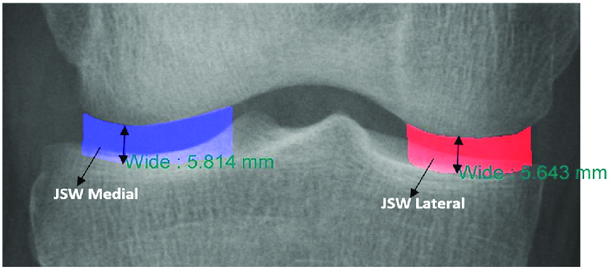
Background & Previous Presentation Recap
Data Description
Conduct OTC
Medial Minimum Joint Space Width (Outcome): measured in millimeters (mm), represents the minimum distance between the femur and tibia within the knee joint.
• A larger JSW: healthier cartilage and less structural degeneration.
• A smaller JSW: cartilage loss and narrowing of the joint space.
Instructor: Tony Panzarella
CHL5222H: Laboratory in Statistical Design and Analysis
3/12
2026-04-23
2026-04-22
1/12

Slide 4
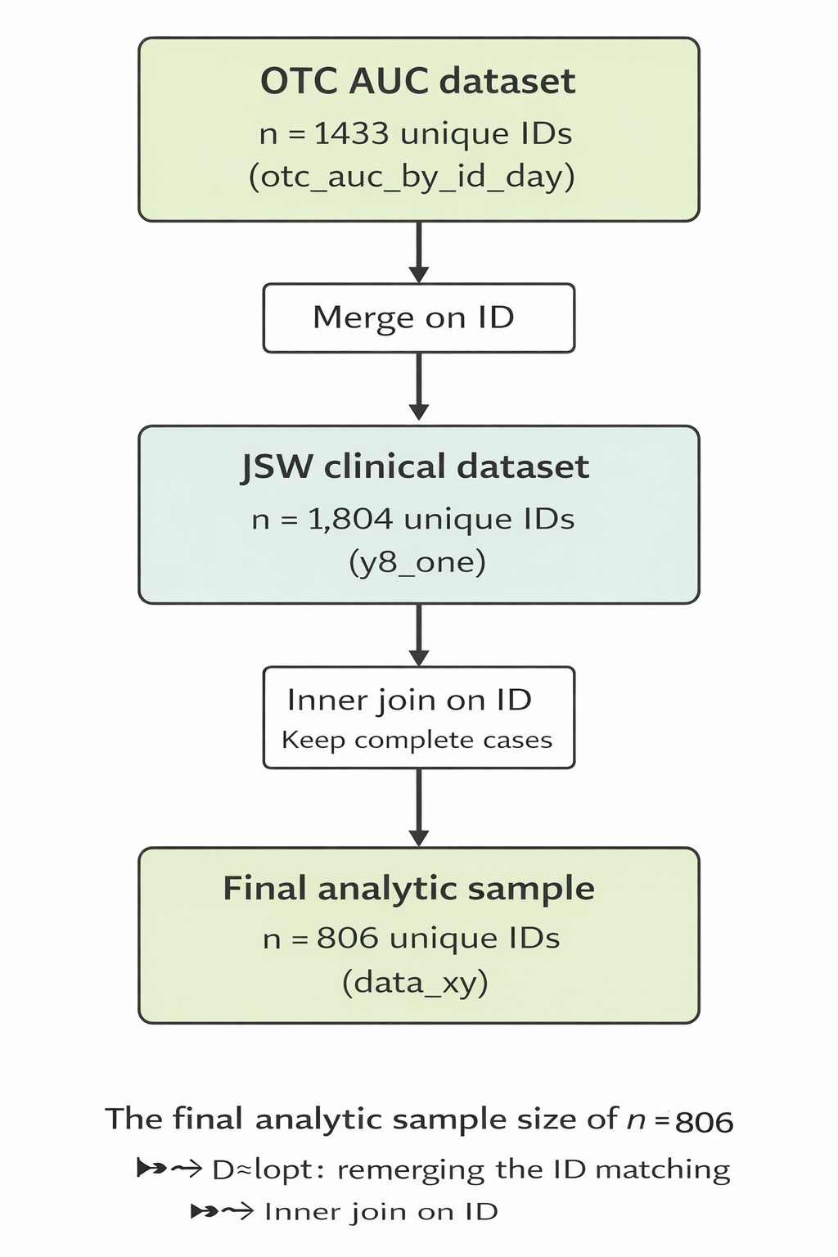



Background & Previous Presentation Recap
OTC→AUC
Add Outcome
Why this method?
Functional Data Representation
Variable | Description
$$Y_i$$ | Outcome (Medial Minimum Joint Space Width)
HRT/DIA | Additional covariate (currently not select)
MNACT5 | Area under the activity curve across intensity intervals (Summary of time spent)
Instructor: Tony Panzarella
CHL5222H: Laboratory in Statistical Design and Analysis
4/12
2026-04-23
2026-04-22
1/12

Slide 5
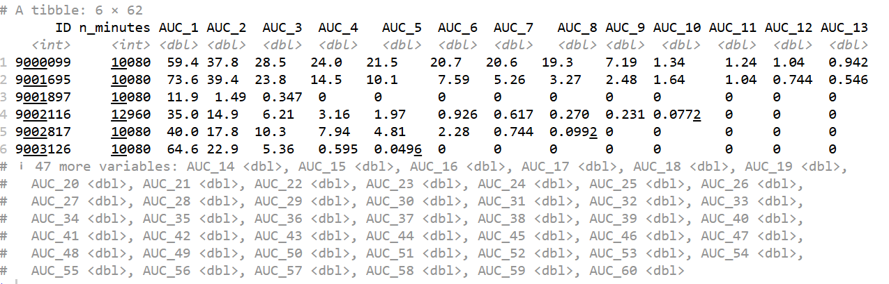
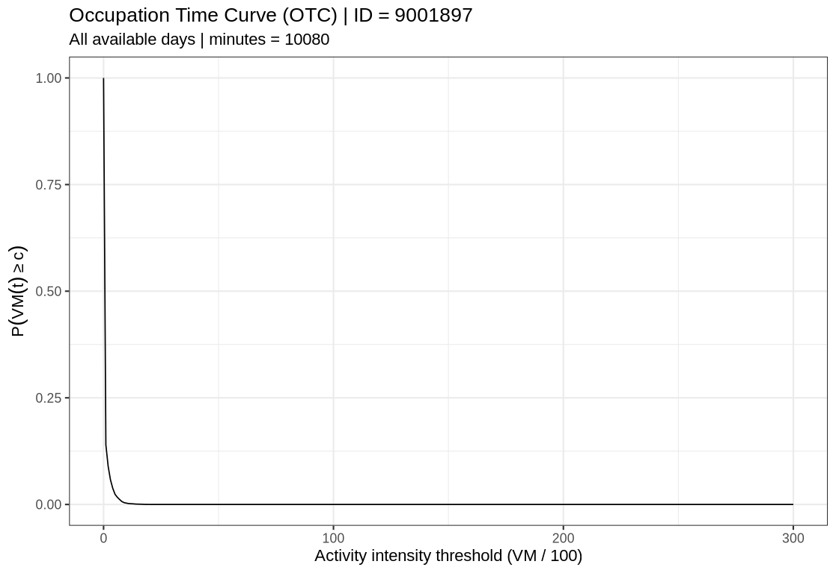
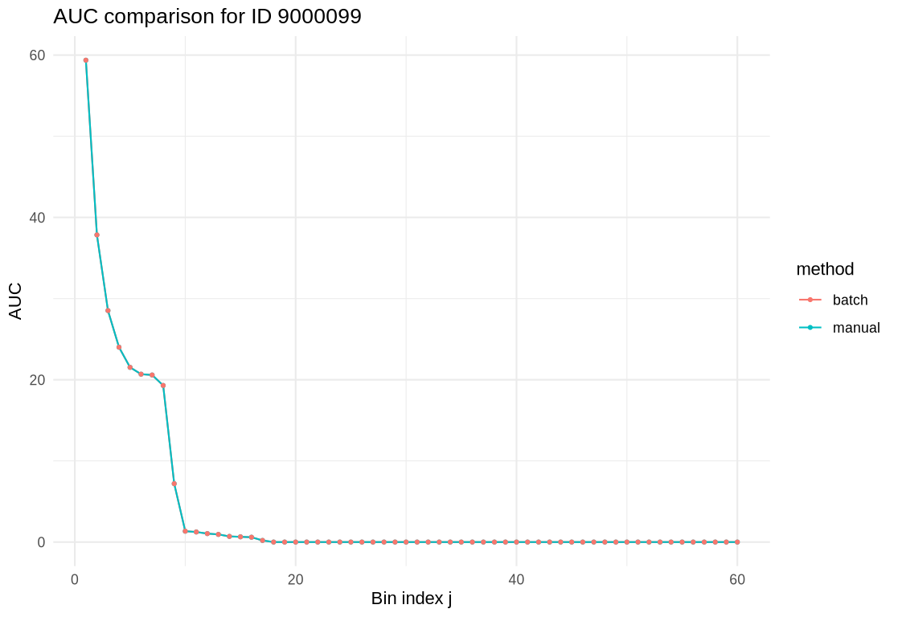
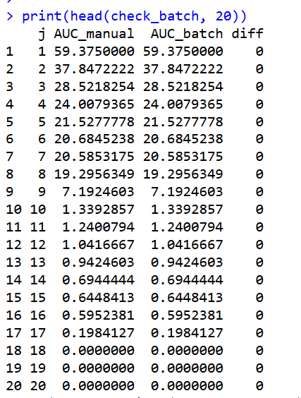
Method: Implementation Challenge
AUC Validation
Standardization
Instructor: Tony Panzarella
CHL5222H: Laboratory in Statistical Design and Analysis
5/12
2026-04-23
2026-04-22
1/12

Slide 6




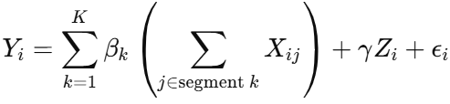
Method: Optimization-Based Functional Modeling
Functional Model Establishment
Ideal Model:
Set:
This stabilizes and enables interpretation of intensity ranges.
This model directly captures how the effect varies with activity intensity.
Substitute the piecewise-constant assumption into the original model,
Since the observed activity data are discrete rather than continuous,
Alternative Model:
Final Model:
Build a discrete approximation of a functional regression.
Convert pointwise effects into segment-level effects.
Due to high correlation across AUCs and high dimension,
• Dimensionality reduction (J → K)
• Improved stability by reducing multicollinearity
• Enhanced interpretability via segment-level effects
Instructor: Tony Panzarella
CHL5222H: Laboratory in Statistical Design and Analysis
6/12
2026-04-23
2026-04-22
1/12

Slide 7
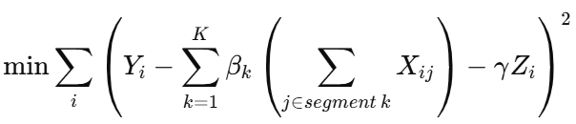

Method: Optimization-Based Functional Modeling
Optimization
Model Selection
Use mixed-integer optimization to jointly determine segment membership, cutpoints, and segment-specific effects.
Optimization formulation:
minimize the Residual Sum of Squares (RSS)
Select the optimal number of segments K using BIC.
n: subject size (804)
p: parameter size: (betas(K)+gamma(1)+cutpoint(K-1))
For each selected value of K,
we estimate the corresponding segment specific coefficients under the segmentation constraints.
This balances model fit and model complexity:
A larger K allows more flexibility;
A smaller K leads to a simpler and more interpretable model.
Instructor: Tony Panzarella
CHL5222H: Laboratory in Statistical Design and Analysis
7/12
2026-04-23
2026-04-22
1/12

Slide 8
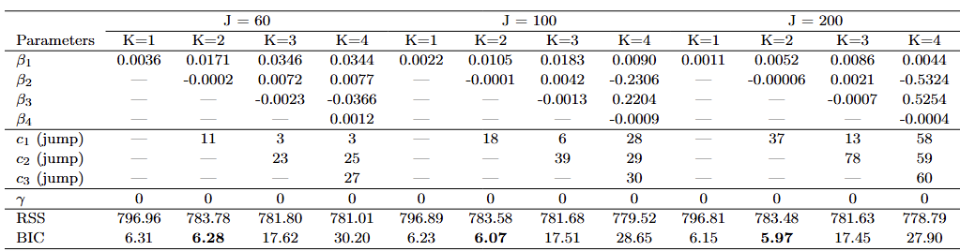
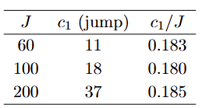
Result & Discussion: Current Achievement
Model Performance
Result Interpretion
• The association between activity intensity and joint health is primarily driven by lower intensity activity.
• Engaging in light to moderate activity is more strongly associated with maintaining joint space, which reflects healthier cartilage and less structural degeneration.
• Increasing activity intensity beyond the identified cutpoint does not appear to provide additional benefit for joint health.
• A two-segment model: consistent
• The cutpoint: approximately 18% of the intensity range.
• Below this cutpoint: activity has a positively associated with the outcome.
• Above this cutpoint: the association becomes slightly negative (negligible).
• This suggests that the association is concentrated in lower intensity ranges.
Instructor: Tony Panzarella
CHL5222H: Laboratory in Statistical Design and Analysis
8/12
2026-04-23
2026-04-22
1/12

Slide 9




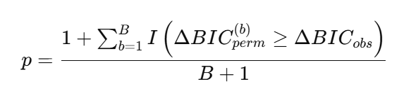
Result & Discussion: Current Achievement
Permutation Test
Null hypothesis: The two-segment model is unnecessary: .
Test Result
measures how much the two-segment model (K=2) improves over the one-segment model (K=1) for observed data.
In each permutation, we randomly shuffle JSW while keeping AUC fixed, creating a dataset with no association between activity and the outcome.
Permutaed number | P-value
B = 50 | 0.0196
B = 80 | 0.0123
B = 100 | 0.0099
is the improvement of the two-segment model over the one-segment model computed on the b-th permuted dataset.
Repeating this process B times produces a set of ΔBIC values that form the null distribution under no association.
• Improvement of K=2 over K=1 is statistically significant.
• The null hypothesis is evidently rejected.
• The permutation test supports the two-segment model structure.
Here, the indicator function counts how often the permuted ΔBIC exceeds the observed ΔBIC.
The p-value is computed as the proportion of permuted datasets where the improvement in model fit (ΔBIC) is at least as large as that observed in the original data.
Instructor: Tony Panzarella
CHL5222H: Laboratory in Statistical Design and Analysis
9/12
2026-04-23
2026-04-22
1/12

Slide 10
Result & Discussion: Future Arrangement
Instructor: Tony Panzarella
CHL5222H: Laboratory in Statistical Design and Analysis
10/12
2026-04-23
2026-04-22
1/12

Slide 11

Reference Page
Duryea, J., Neumann, G., Niu, J., & Hunter, D. J. (2007). Comparison of radiographic joint space width measurement methods in knee osteoarthritis. Osteoarthritis and Cartilage, 15(6), 666–672.
Hunter, D. J., Zhang, Y., Niu, J., Tu, X., Amin, S., Clancy, M., & Felson, D. T. (2009). The association of cartilage loss with joint space narrowing in knee osteoarthritis. Arthritis & Rheumatism, 60(3), 917–924.
Dunlop, D. D., Song, J., Semanik, P. A., Sharma, L., Bathon, J. M., Eaton, C. B., & Chang, R. W. (2011). Physical activity levels and functional performance in the osteoarthritis initiative. Arthritis Care & Research, 63(12), 1773–1780.
White, D. K., Tudor-Locke, C., Zhang, Y., Fielding, R. A., LaValley, M., Felson, D. T., & Nevitt, M. C. (2017). Daily walking and the risk of incident functional limitation in knee osteoarthritis. Arthritis Care & Research, 69(6), 857–865.
Pahor, M., Guralnik, J. M., Ambrosius, W. T., Blair, S., Bonds, D. E., Church, T. S., & LIFE Study Investigators. (2014). Effect of structured physical activity on prevention of major mobility disability in older adults. JAMA, 311(23), 2387–2396.
Banker, M., Zhang, L., & Song, P. X. K. (2023). Regularized scalar-on-function regression analysis to assess functional association of critical physical activity window with biological age.
Instructor: Tony Panzarella
CHL5222H: Laboratory in Statistical Design and Analysis
11/12
2026-04-23
2026-04-22
1/12

Slide 12
Thank you for watching
Welcome to ask questions
Instructor: Tony Panzarella
CHL5222H: Laboratory in Statistical Design and Analysis
12/12
2026-04-23
2026-04-22
1/12

